Slide 1
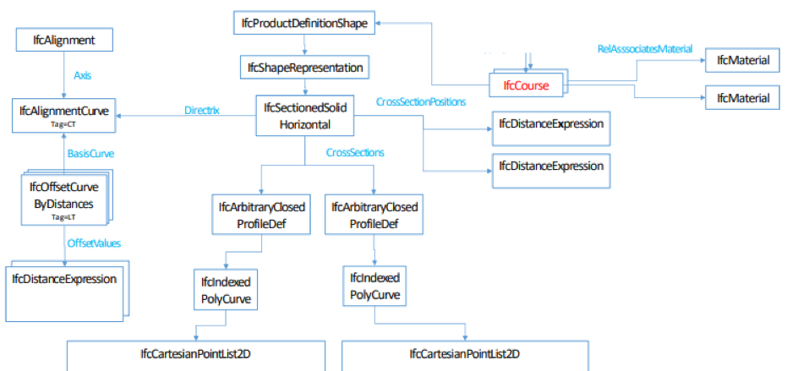
IfcAlignment / IfcCourse Example
Diagramm

Slide 2
IfcAlignment
IfcAlignmentHorizontal
X = 513220.00000
Y = 5454120.00000
DistanceAlong = 14.14214
PredefinedType = LINE
StartDirection = 0.785
SegmentLength = 14.14214
X = 513210.00000
Y = 5454110.00000
DistanceAlong = 0.0

Slide 3
IfcAlignment
IfcAlignmentVertical
X = 14.14
Y = 92.0
StartDistAlong = 0
StartGradient = 0.0707
EndGradient = 0.0707
PredefinedType = LINE
StartHeight = 91.0
HorzontalLength = 14.14214
X = 0.0
Y = 91.0

Slide 4
IfcCourse
IfcSectionSolidHorizontal at DistanceAlong = 0
Tag = 5
X = 3.0
Y = 0.1
Tag = 4
X = 0.0
Y = 0.0
Tag = 3
X = -3.0
Y = -0.1
DistanceAlong = 0.0
OffsetVertical = 91.0
Tag = 6
X = 3.0
Y = -0.9
Tag = 1,7
X = 0.0
Y = -1.0
Tag = 2
X = -3.0
Y = -1.1

Slide 5
IfcCourse
IfcSectionSolidHorizontal at DistanceAlong = 14.142
Tag = 5
X = 3.0
Y = 0.1
Tag = 4
X = 0.0
Y = 0.0
Tag = 3
X = -3.0
Y = -0.1
DistanceAlong = 14.142
OffsetVertical = 92.0
Tag = 6
X = 3.0
Y = -0.9
Tag = 1,7
X = 0.0
Y = -1.0
Tag = 2
X = -3.0
Y = -1.1

Slide 6
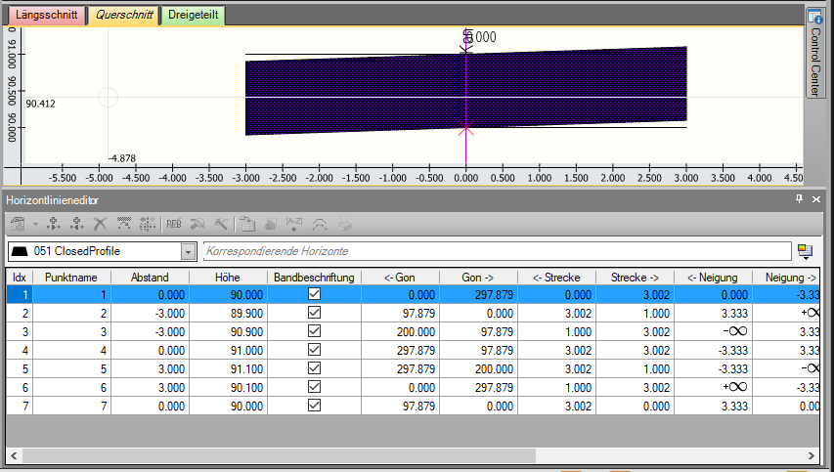
View in VESTRA INFRAVISION Crosssection at DistanceAlong = 0

Slide 7
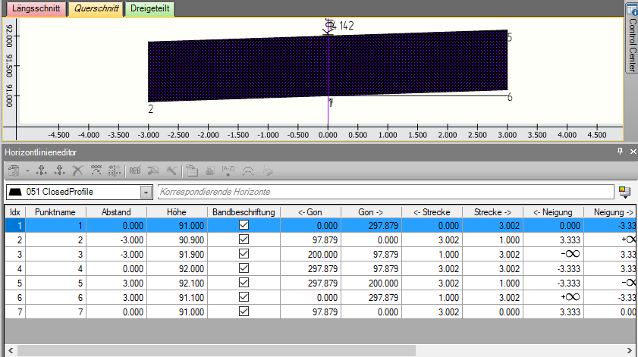
View in VESTRA INFRAVISION Crosssection at DistanceAlong = 14.142

Slide 8
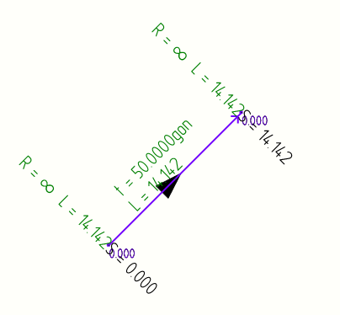
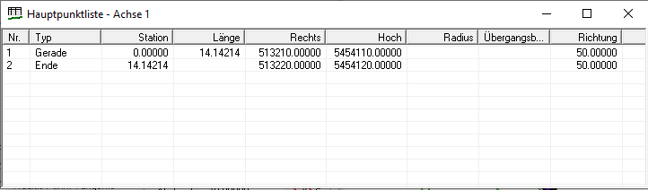
View in VESTRA INFRAVISION IfcAlginmentHorizontal

Slide 9
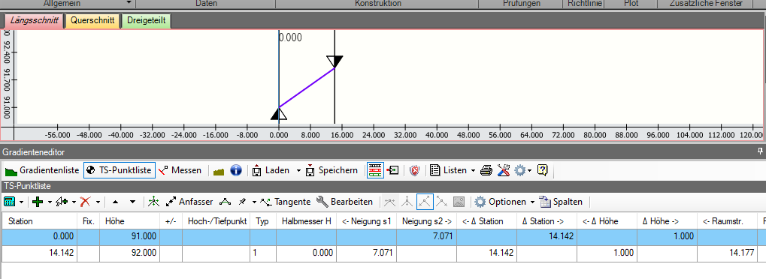
View in VESTRA INFRAVISION IfcAlignmentVertical

Slide 10
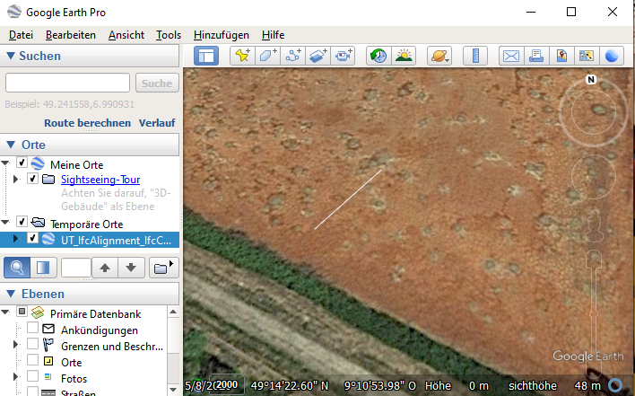
Shapeimport alignment in Google Earth
#12 = IFCPROJECTEDCRS('EPSG:25832', 'ETRS89_UTM32', 'EPSG:25832', 'EPSG:25832', 'UTM', '32', #6);

